Slide 1

Voice Bot Project A Conversational AI using Speech Recognition and Python
Presented by- GAURI VINOD CHAUDHARI
Intern id- MST03-0072
Guided by-urooj khan

Slide 2
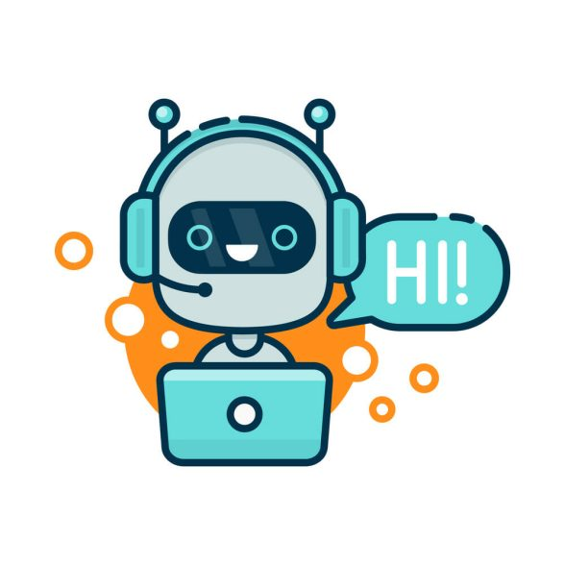
What is a Voice Bot?
A voice bot is a software application that can interact with users using voice commands and responses.
It leverages speech recognition and text-to-speech (TTS) technologies to simulate human conversation.
A voice bot is an artificial intelligence (AI)-driven system that can interact with users through voice commands and natural language. These bots are designed to recognize, interpret, and respond to spoken language, enabling users to engage in conversations as they would with another human.

Slide 3
Key Components of a Voice Bot
Speech Recognition (ASR - Automatic Speech Recognition)
Converts spoken language into text. Tools like Google's Speech-to-Text, Amazon Transcribe, and open-source libraries like ‘speechRecognition’ or ‘vosk’ are commonly used
Natural Language Processing (NLP)
Interprets and understands the meaning behind the text.
This involves recognizing intent, extracting key information, and understanding context.
Common frameworks include Dialogflow, Rasa, and Microsoft LUIS.
Dialog Management
Controls the flow of conversation. This includes maintaining context, managing multi-turn conversations,
and handling various scenarios like clarifications, confirmations, or errors.
Text-to-Speech (TTS)
Converts text-based responses into spoken language. Tools like Google Text-to-Speech, Amazon Polly, and open-source options like’pyttsx3’ are often used.

Slide 4
How a Voice Bot Works:
Size: Large datasets help models learn intricate patterns and reduce overfitting.
Voice Input:
The user speaks into a microphone. The voice bot captures this audio input.
Speech Recognition:
The voice bot processes the audio to convert it into text using ASR.
Natural Language Processing:
The bot interprets the text to understand the user’s intent and extracts any necessary information.
Response Generation:
Based on the intent and context, the bot generates a response. This could involve answering a question, performing an action, or asking for more information.
Text-to-Speech:
The bot converts the response into audio, which is then played back to the user.
Voice Output:
The bot’s response is delivered to the user as spoken language.

Slide 5
Common Use Cases for Voice Bots
Customer Service:
Handling inquiries, processing requests, or guiding users through troubleshooting.
Virtual Assistants:
Examples include Siri, Alexa, and Google Assistant, which perform tasks, answer questions, and control smart home devices.
Interactive Voice Response (IVR) Systems:
Automating phone systems to handle common queries or direct calls to the appropriate department.
Healthcare:
Assisting with appointment scheduling, medication reminders, or providing information.
Technologies Used
Programming Languages:
Python, JavaScript, or Go.
APIs and Frameworks:
Google Dialogflow, Amazon Lex, Microsoft Bot Framework, and open-source frameworks like Rasa.

Slide 6
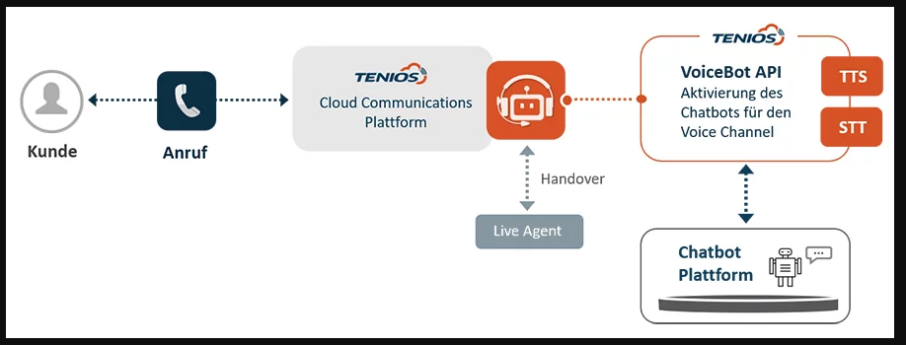
Architecture Overview
Architecture Overview
Title: Architecture of a Voicebot
Content:
User Input: Voice input captured through a microphone
Speech Recognition: Translates voice to text
NLP Engine: Processes the text and determines intent
Response Generation: Generates a suitable response
Text-to-Speech: Converts the response to speech
Output: Delivers the response to the user
Diagram: Include a flowchart or diagram illustrating the architecture.

Slide 7
Technology Stack
Title: Technology Stack
Content:
Speech Recognition Libraries: e.g., Google Speech-to-Text,
NLP Libraries: e.g., OpenAI GPT,
TTS Libraries: e.g., gTTS,
Frameworks: e.g., Streamlit,

Slide 8
Implementation Example:
Title: Implementation Example Content:
Overview: Description of your specific voicebot implementation.
Code Snippets:
Speech Recognition Setup: Example code to capture and process audio.
NLP Integration: Code to send user input to an AI model and receive a response.
Text-to-Speech Conversion: Example code to generate and play spoken responses.
Workflow: Step-by-step flow of how audio is processed and how the response is generated.

Slide 9
Use Cases:
Use Cases and Applications Content:
Customer Service: Automated support systems handling common queries and issues.
Healthcare: Virtual health assistants providing information and monitoring.
Entertainment: Interactive games and personal assistants enhancing user experience.
Education: Tutoring systems providing interactive learning experiences.

Slide 10
Challenges and Solutions
Content:
Speech Recognition Accuracy:
Challenge: Accents, background noise.
Solution: Use noise-canceling microphones, train models on diverse datasets.
NLP Limitations:
Challenge: Understanding context, managing diverse queries.
Solution: Use advanced NLP models, continuously improve training data.
Data Privacy:
Challenge: Secure handling of sensitive information.
Solution: Implement encryption, follow best practices for data protection.

Slide 11
CONCLUSION :
Voicebots represent a significant advancement in human-computer interaction, leveraging speech recognition, natural language processing, and text-to-speech technology to create seamless, efficient, and natural user experiences
With applications ranging from customer service to healthcare, voicebots are revolutionizing how we interact with technology, making it more intuitive and accessible.
Despite challenges such as speech recognition accuracy and data privacy, ongoing advancements in AI and machine learning are continuously improving the capabilities and reliability of voicebots.

Slide 12
THANK YOU

